Slide 1
Module– 3 – Contents Problem Solving by searching, Probabilistic reasoning in AI
Solving problems by searching
Classical Search
Adversarial Search
Constraint Satisfaction Problems.
Probabilistic reasoning in AI
Bayesian networks
Hidden Markov Model.

Slide 2

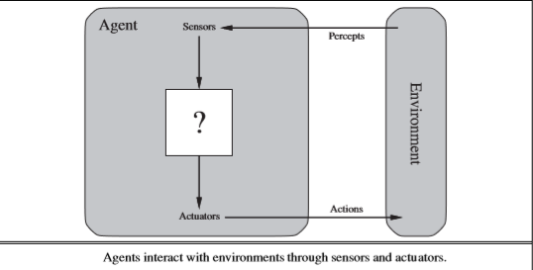
Agent & Environment
‘Anything’ that can gather information about its environment and take action based on that information.
In AI, an intelligent agent (IA) is an autonomous entity which observes through sensors and acts upon an environment using actuators and directs its activity towards achieving goals.
Intelligent agents may also learn or use knowledge to achieve their goals.
A rational agent is one that acts so as to achieve the best outcome or, when there is uncertainty, the best expected outcome.

Slide 3
Agents
A human agent
eyes, ears, and other organs for sensors
hands, legs, vocal tract, and so on for actuators.
A robotic agent
might have cameras and infrared range ﬁnders for sensors
various motors for actuators.
A software agent
receives keystrokes, ﬁle contents, and network packets as sensory inputs
acts on the environment by displaying on the screen, writing ﬁles, and sending network packets.

Slide 4
Agent…
Percept refers to the agent’s perceptual inputs at any given instant.
An agent’s percept sequence is the complete history of everything the agent has ever perceived.
An agent’s choice of action at any given instant can depend on the entire percept sequence observed to date, but not on anything it hasn’t perceived.
Mathematically speaking, we say that an agent’s behavior is described by the agent function that maps any given percept sequence to an action
One could view a hand-held calculator as an agent that chooses the action of displaying “4” when given the percept sequence “2 + 2 =,”

Slide 5
Solving problems by Searching
Goal-based agent called a Problem-solving Agent.
Uninformed Search Algorithms—algorithms that are given no information about the problem other than its deﬁnition.
Although some of these algorithms can solve any solvable problem, none of them can do so efﬁciently.
Informed Search Algorithms, on the other hand, can do quite well given some guidance on where to look for solutions

Slide 6

Problem : Travel from Bangalore to Mysore
If the agent has no additional information—i.e., if the environment is unknown in the sense—then it is has no choice but to try one of the actions at random.
But suppose the agent has a map of Karnataka
The point of a map is to provide the agent with information about the states it might get itself into and the actions it can take.
The agent can use this information to consider subsequent stages of a hypothetical journey via each of the towns, trying to ﬁnd a journey that eventually gets to Mysore.
Once it has found a path on the map from Bangalore to Mysore, it can achieve its goal by carrying out the driving actions that correspond to the legs of the journey.
An agent with several immediate options of unknown value can decide what to do by ﬁrst examining future actions that eventually lead to states of known value.
OBSERVABLE :The agent always knows the current state.
DISCRETE: At any given state there are only ﬁnitely many actions to choose from
KNOWN : The agent knows which states are reached by each action
DETERMINISTIC : Each action has exactly one outcome
Under these assumptions, the solution to any problem is a ﬁxed sequence of actions.
The process of looking for a sequence of actions that reaches the goal is called search.

Slide 7
Well Defined Problem
A problem can be defined formally by five components:
The initial state that the agent starts in. For example, the initial state for our agent in Bangalore might be described as In(Bangalore).
A description of the possible actions available to the agent.
Given a particular state s, ACTIONS(s) returns the set of actions that can be executed in s.
Each of these actions is applicable in s.
For example, from the state In(Bangalore), the applicable
Actions are ----- {Go(Hosur), Go(Kunigal), Go(Kolar)}.
A description of what each action does; the formal name for this is the transition model, specified by a function RESULT(s, a) that returns the state that results from doing action a in state s.
We also use the term successor to refer to any state reachable from a given state by a single action.
For example, RESULT (In(Bangalore),Go(Hosur)) = In(Hosur) .

Slide 8
Well Defined Problem…..
Together, the initial state, actions, and transition model implicitly define the state space of the problem—the set of all states reachable from the initial state by any sequence of actions.
The state space forms a directed network or graph in which the nodes are states and the links between nodes are actions.
(The map of Karnataka can be interpreted as a state-space graph if we view each road as standing for two driving actions, one in each direction.)
A path in the state space is a sequence of states connected by a sequence of actions.
4. The goal test, which determines whether a given state is a goal state.
Sometimes there is an explicit set of possible goal states, and the test simply checks whether the given state is one of them.
The agent’s goal in Karnataka is the singleton set {In(Mysore)}.
A path cost function that assigns a numeric cost to each path. The problem-solving agent chooses a cost function that reflects its own performance measure.
For the agent trying to get to Mysore, time is of the essence, so the cost of a path might be its length in kilometers.
Cost of a path can be described as the sum of the costs of the individual actions along the path.
The step cost of taking action a in state s to reach state s’ is denoted by c(s, a, s’)
The step costs for Karnataka are route distances.
A solution to a problem is an action sequence that leads from the initial state to a goal state.
Solution quality is measured by the path cost function, and an optimal solution has the lowest path cost among all solutions.
The process of removing detail from a representation is called abstraction. (Like Weather, Road Condition etc.)
The choice of a good abstraction thus involves removing as much detail as possible while retaining validity and ensuring that the abstract actions are easy to carry out.

Slide 9
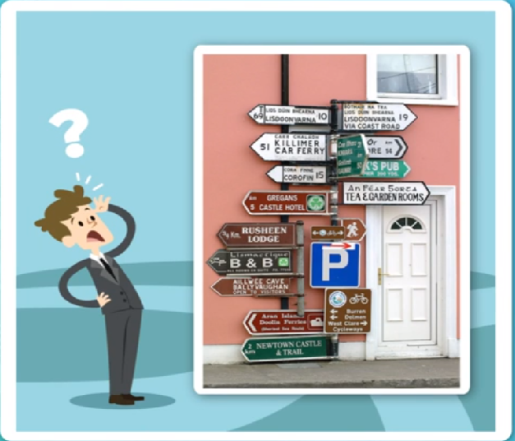

NAVIGATION PROBLEM

Slide 10
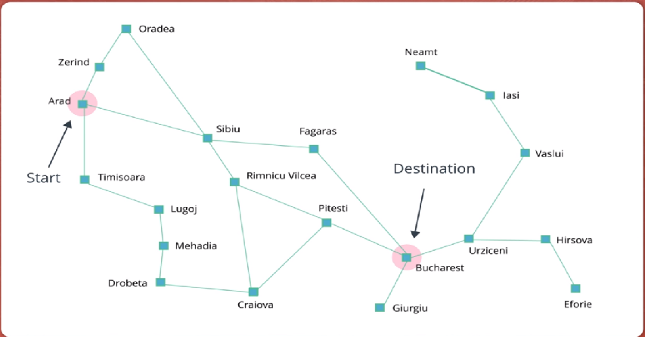
Romania
Problem : Arad To Bucharest
Solution ????

Slide 11
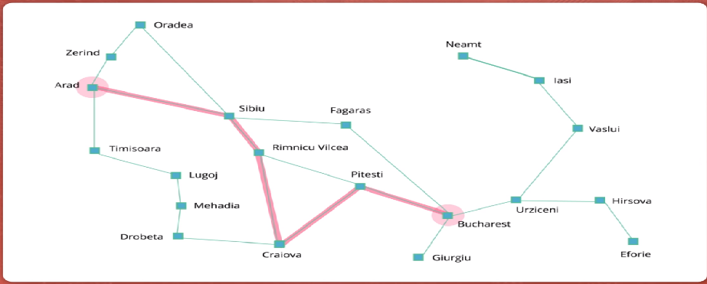
One Solution……

Slide 12
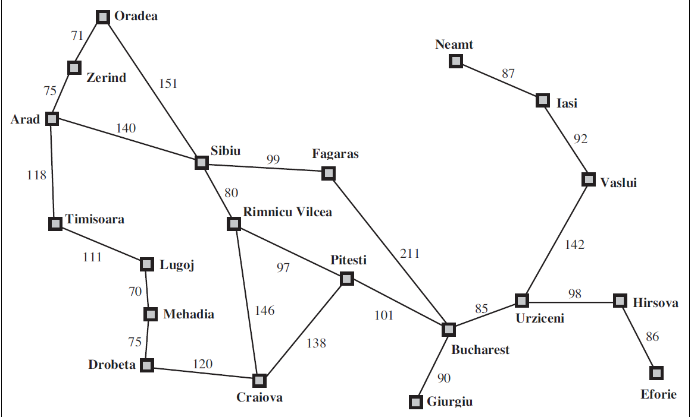
Map of Romania Problem: Arad to Bucharest

Slide 13
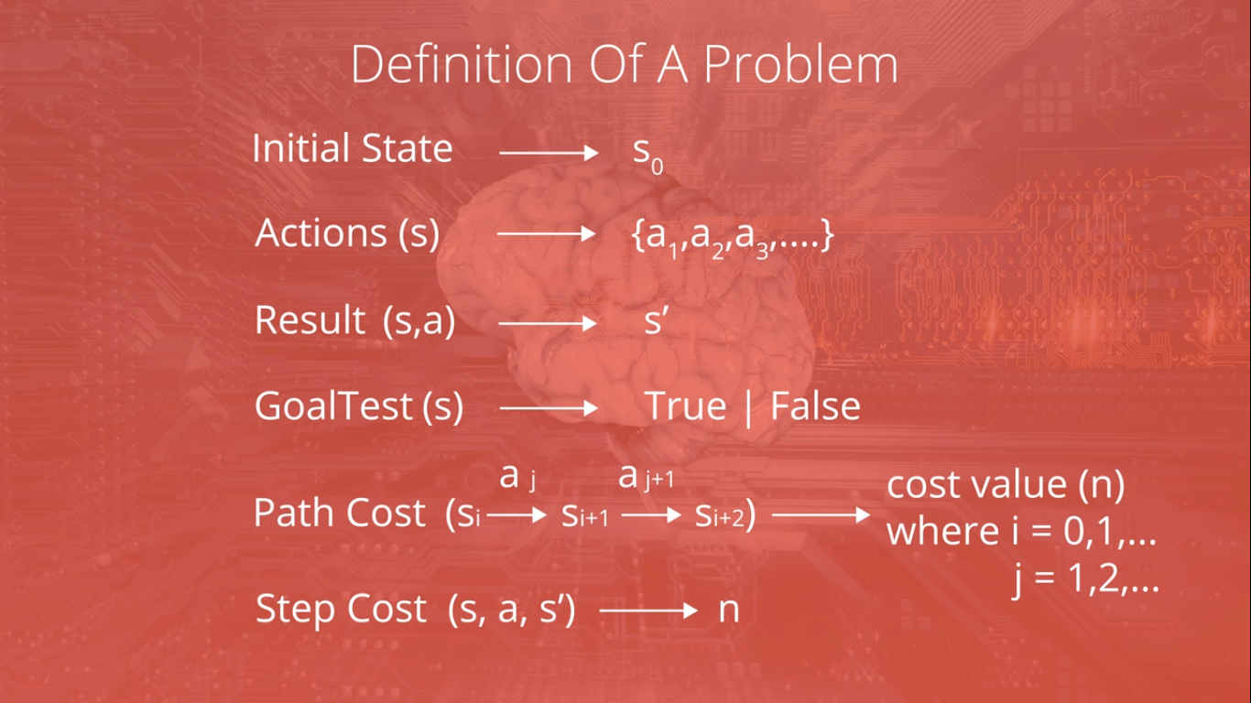

Slide 14
Uninformed Search
These strategies have no additional information about states beyond that provided in the problem definition, so they can only proceed by generating successors until they find a goal state.
BREADTH FIRST
CHEAPEST FIRST
DEPTH FIRST

Slide 15
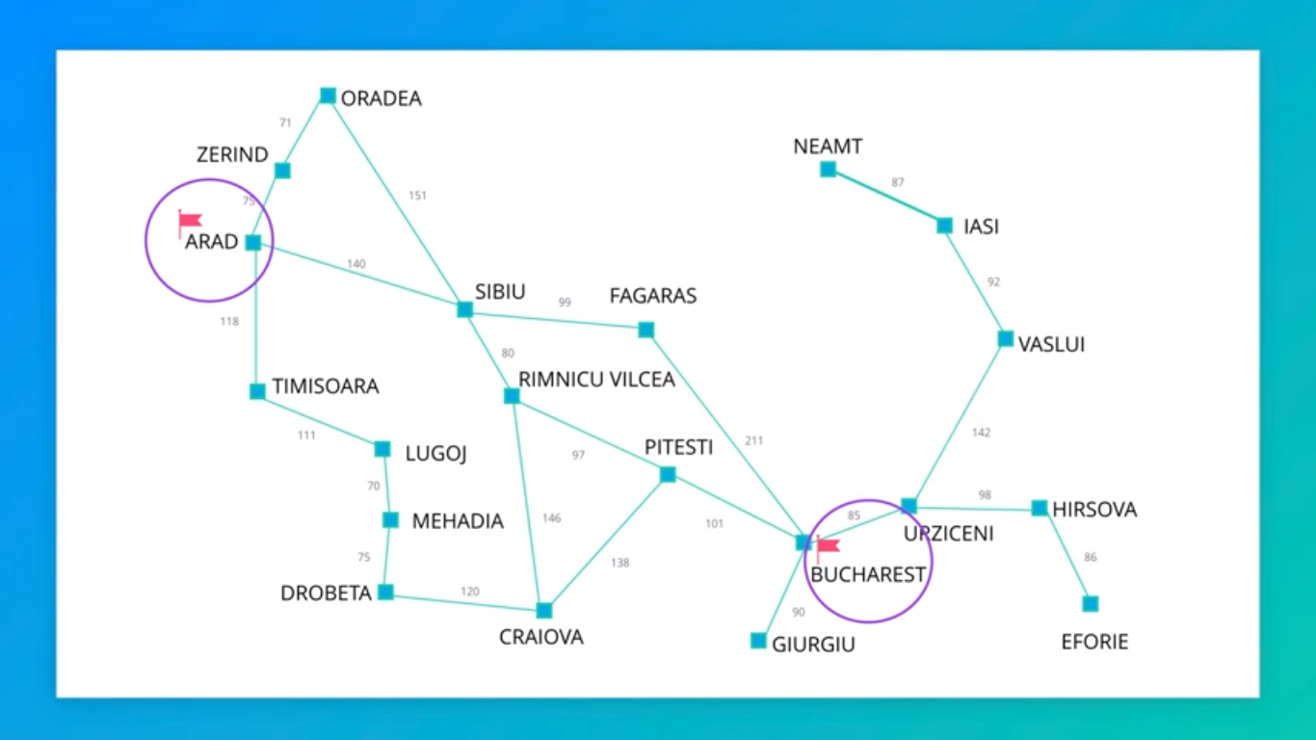

Slide 16
Searching For Solutions
The possible action sequences starting at the initial state form a search tree with the initial state at the root; the branches are actions and the nodes correspond to states in the state space of the problem.
The root node of the tree corresponds to the initial state, In(Arad).
The first step is to test whether this is a goal state. As it is not
We need to consider taking various actions. We do this by expanding the current state; that is, applying each legal action to the current state, thereby generating a new set of states.
In this case, we add three branches from the parent node In(Arad) leading to three new child nodes: In(Sibiu), In(Timisoara), and In(Zerind).
Now we must choose which of these three possibilities to consider further.
Leaf node is a node with no children in the tree.
The set of all leaf nodes available for expansion at any given point is called the frontier.
Loopy Path
Redundant Path

Slide 17
Terms…
State Space : Entire Area
Actions : Navigate the State Space
Actions are specific to each state
Frontier
Explored & Unexplored

Slide 18
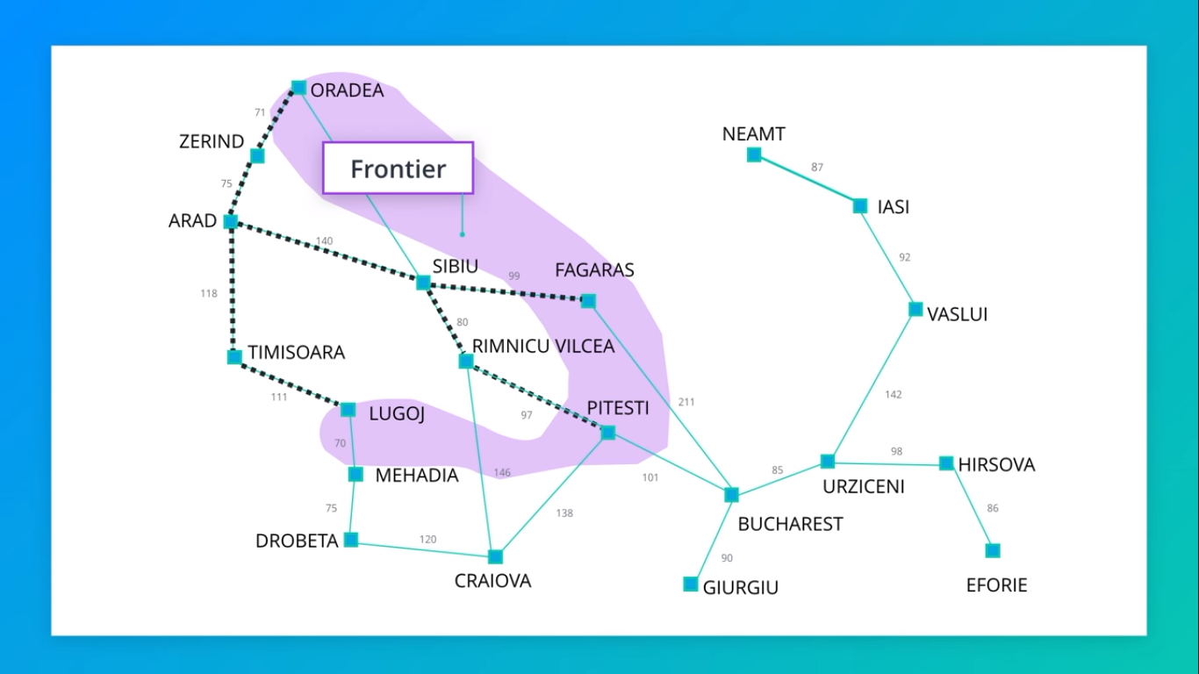

Slide 19
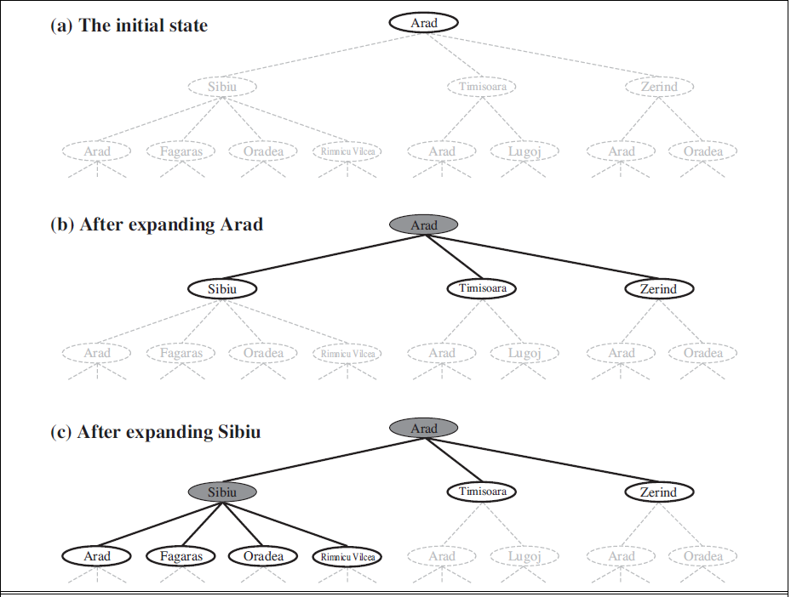

Slide 20
The way to avoid exploring redundant paths is to remember where one has been.
To do this, we augment the TREE-SEARCH algorithm with a data structure called the explored set which remembers every expanded node.
Newly generated nodes that match previously generated nodes—ones in the explored set or the frontier—can be discarded instead of being added to the frontier.
The new algorithm, called GRAPH-SEARCH
In GS the frontier separates the state-space graph into the explored region and the unexplored region, so that every path from the initial state to an unexplored state has to pass through a state in the frontier

Slide 21
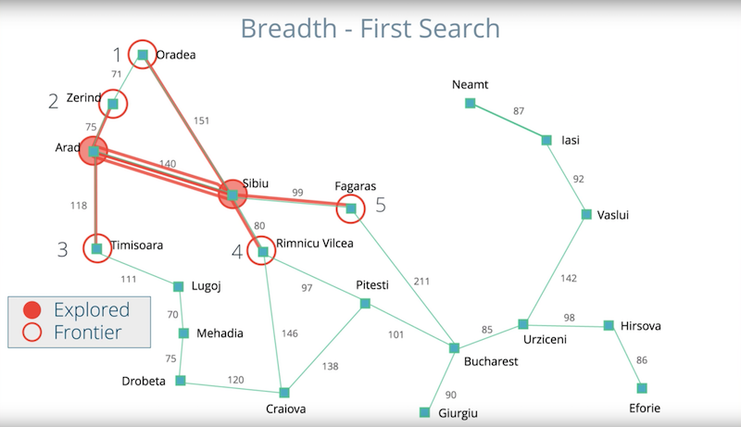
Breadth FIRST SEARCH / Shortest FIRST SEARCH
NEXT WHICH To Explore ????

Slide 22
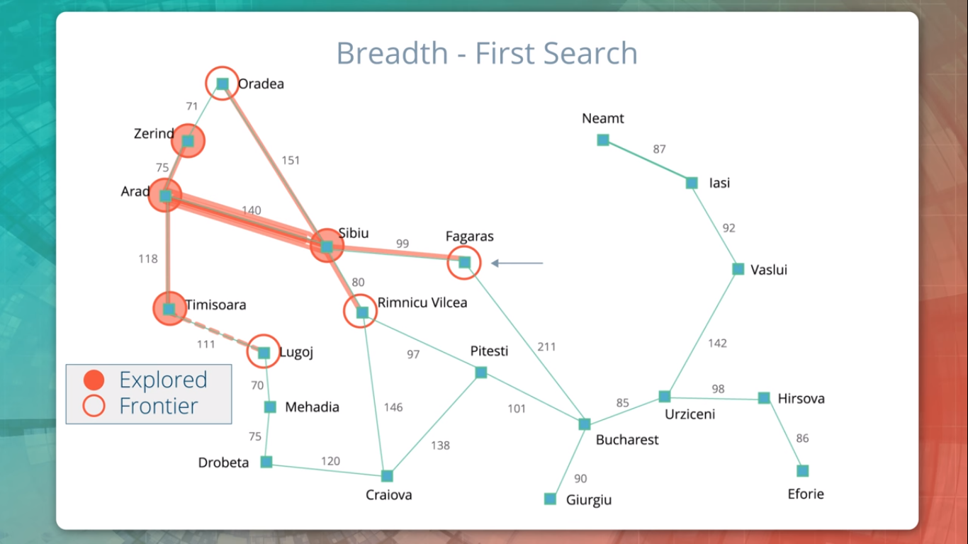
Which Next ???
Do We Terminate ???

Slide 23
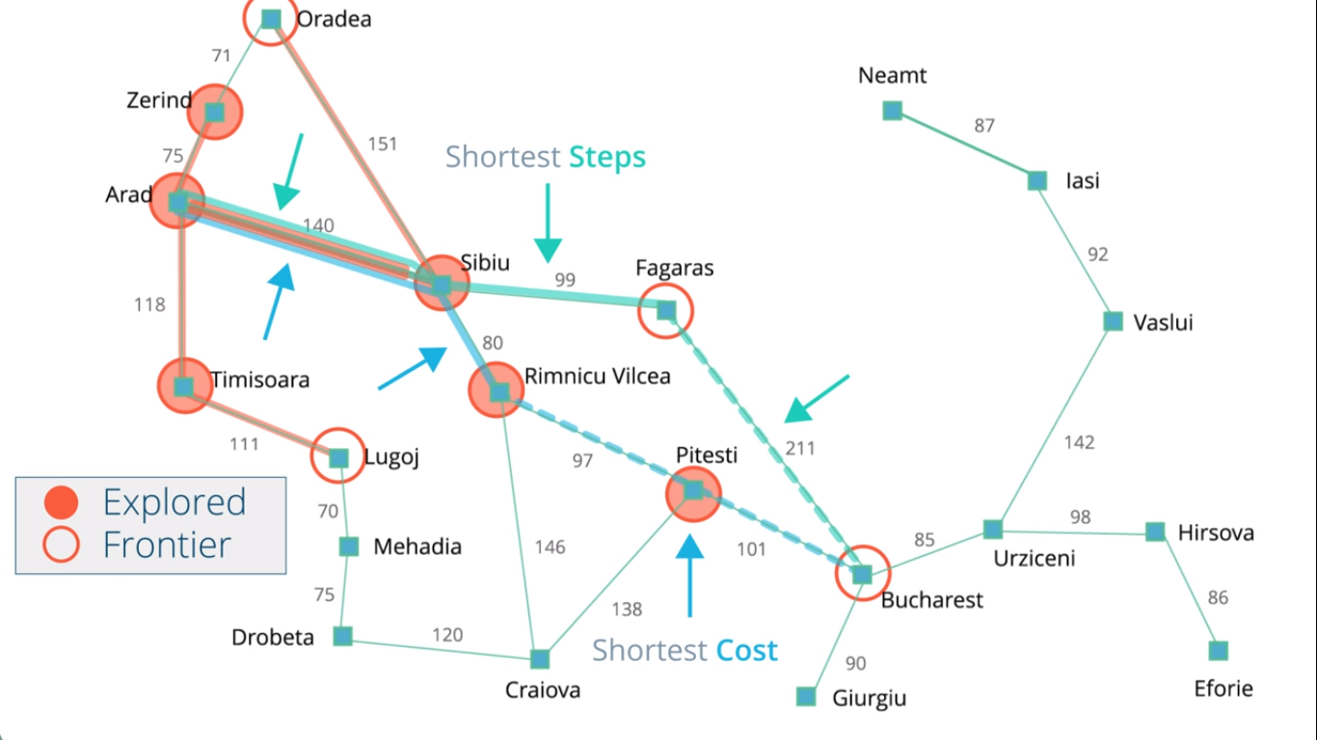

Slide 24
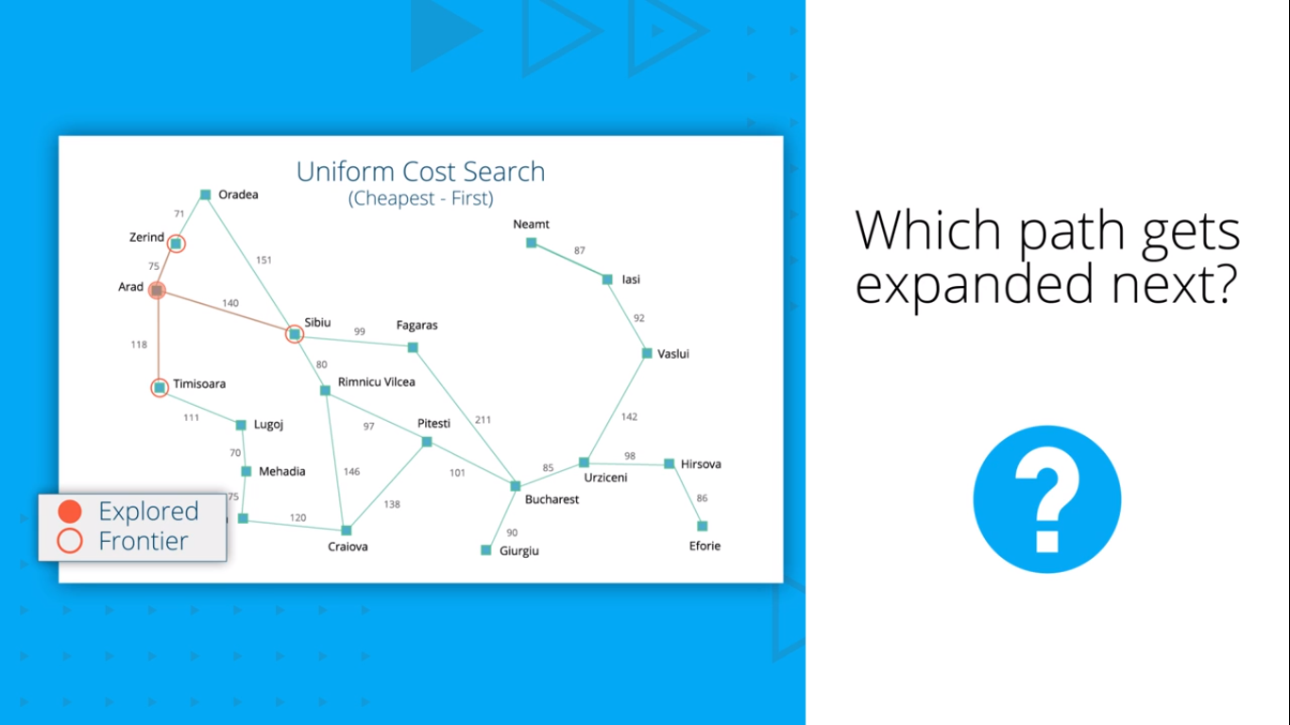
UNIFORM- COST SEARCH/Cheapest First

Slide 25
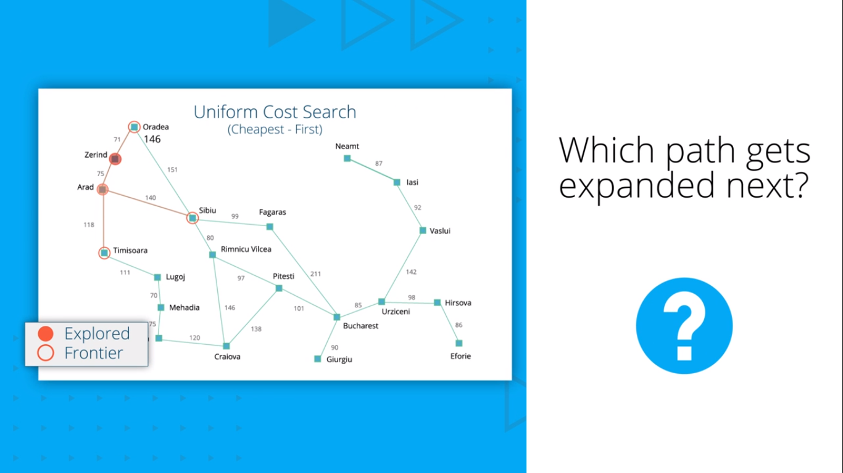

Slide 26


Slide 27
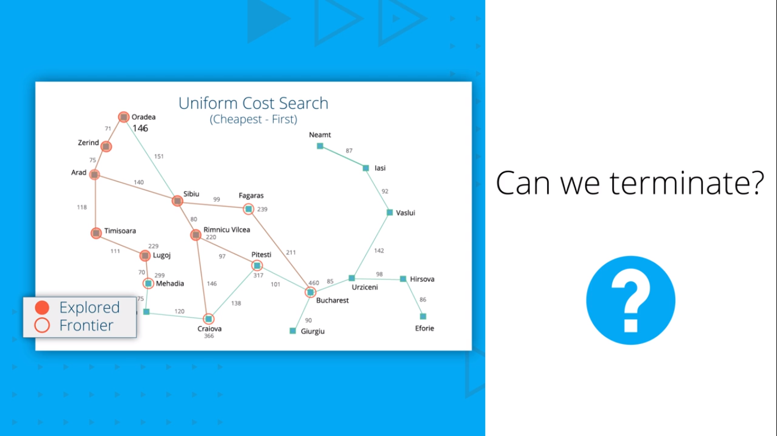

Slide 28
UNIFORM COST SEARCH CONTINUES TILL WE POP OFF THE PATH FROM THE FRONTIER

Slide 29
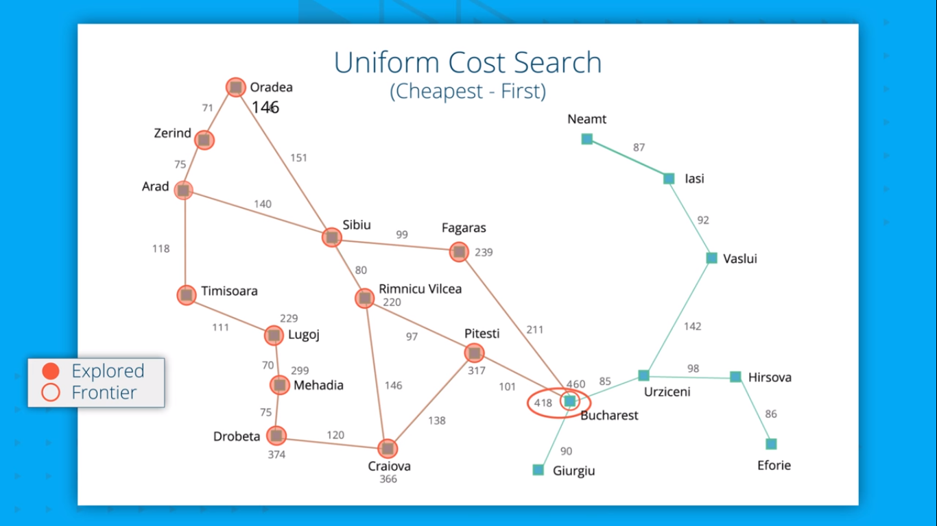

Slide 30
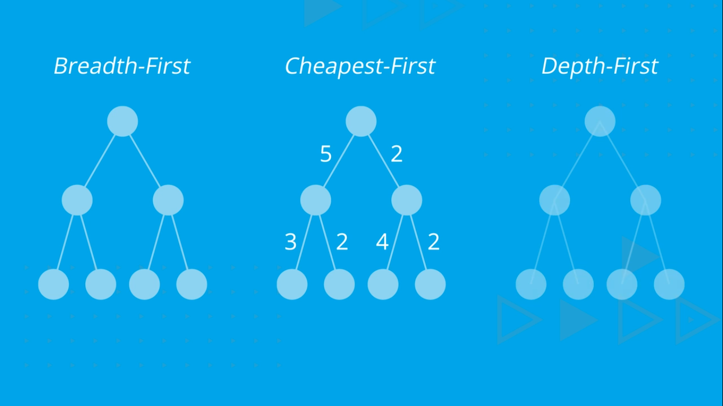
NUMBER IT IN ORDER OF PROCESSING BREAK TIE FROM LEFT TO RIGHT

Slide 31
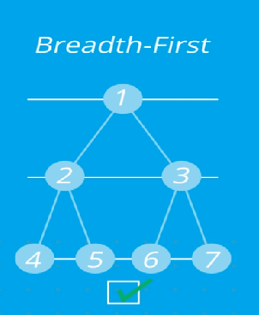
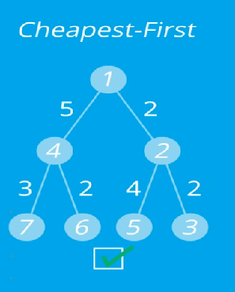
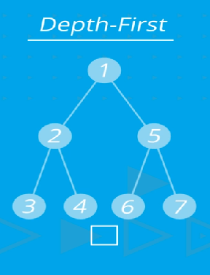

Slide 32
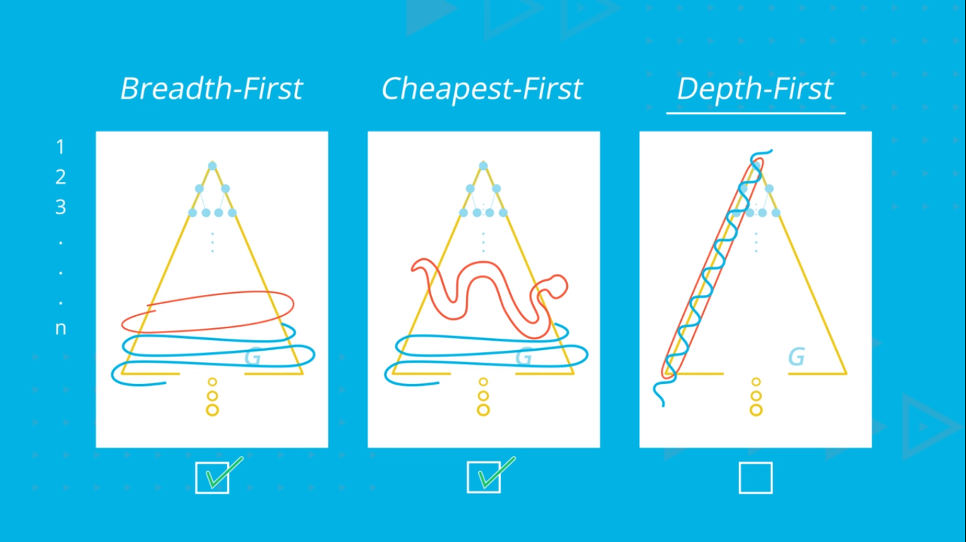
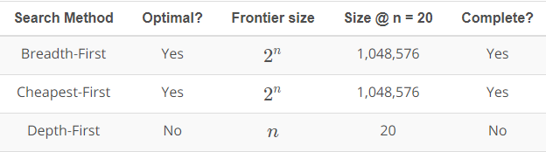

Slide 33
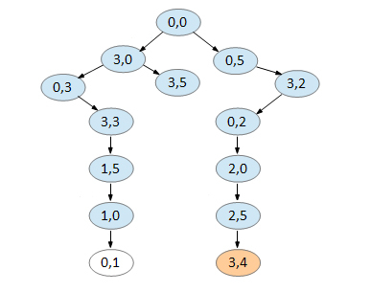
“You are given a 5 litre jug and a 3 litre jug. Both the jugs are initially empty. The jugs don’t have markings to allow measuring smaller quantities. You have to use the jugs to collect 4 litres of water.”
Solve the water jug problem given below using BFS. Specify the state space, the rules applied and the final solution.

Slide 34
INFORMED SEARCH / (HEURISTIC SEARCH)
These strategies have additional information about search states, so they can guide the search by ranking successors according to some fitness score until they find a goal state.
Greedy best-first search
A* Search

Slide 35
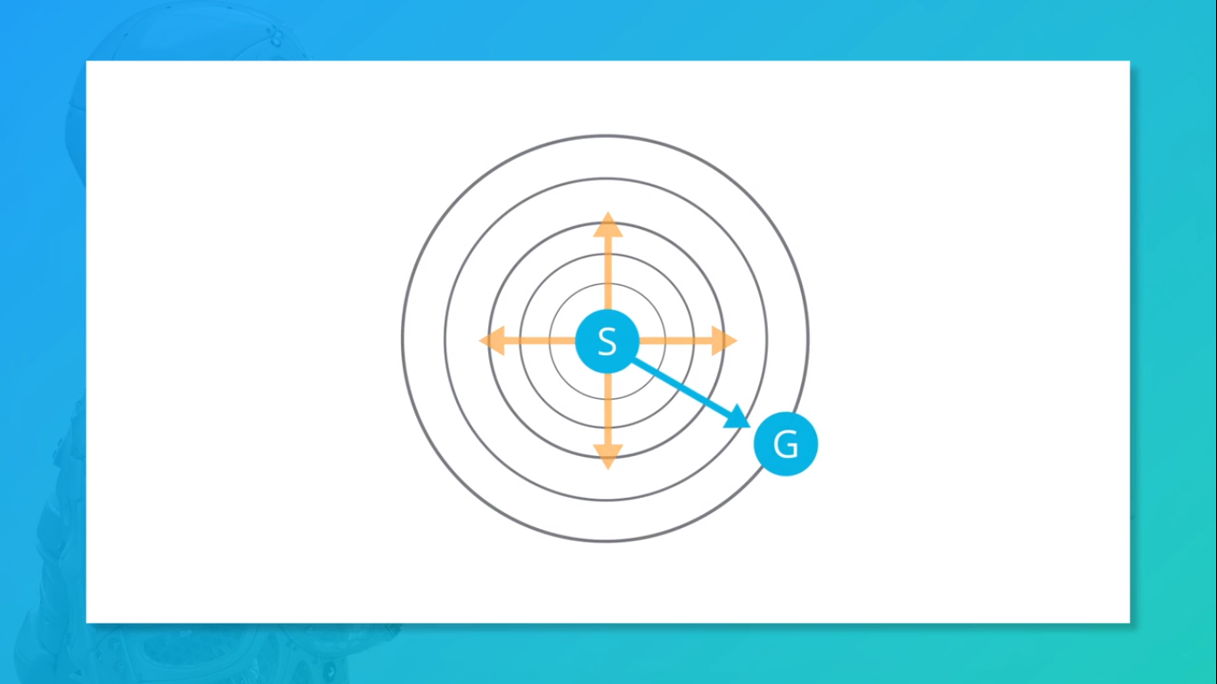

Slide 36
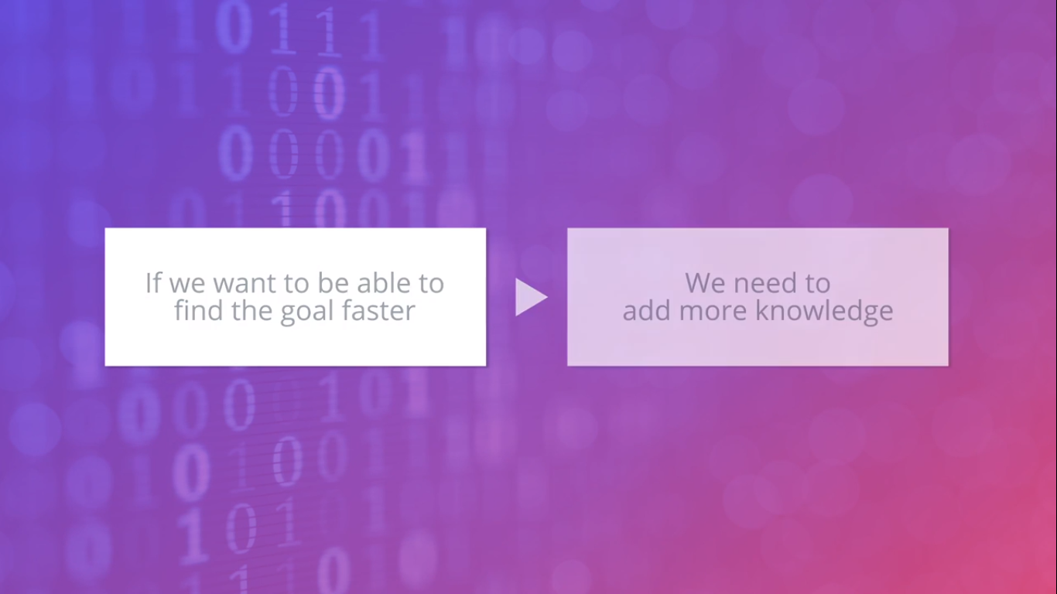

Slide 37
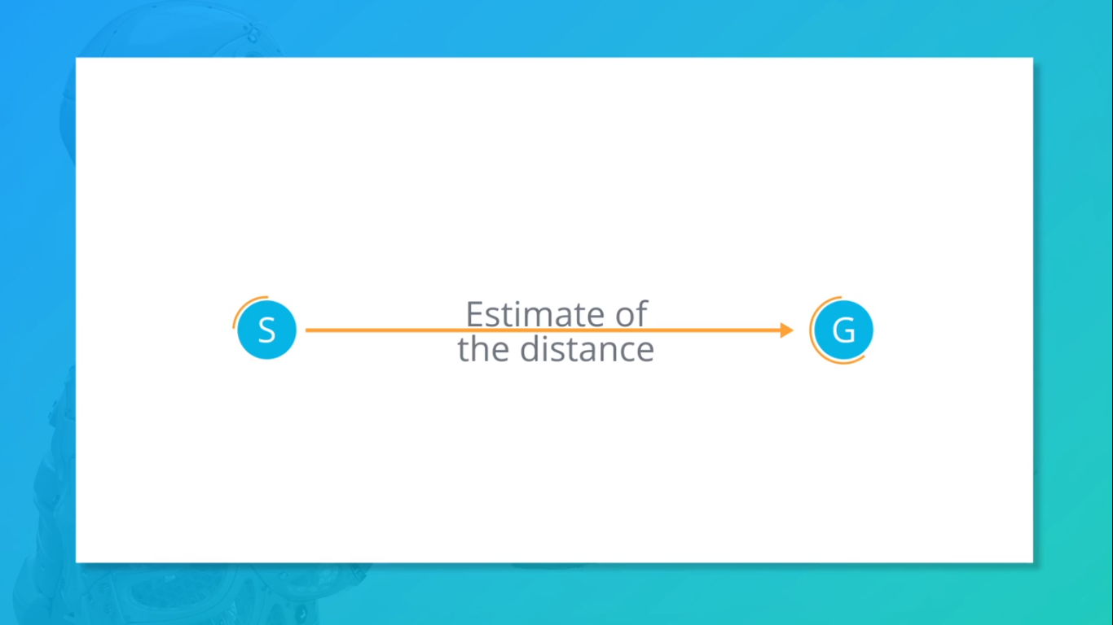

Slide 38


Slide 39


Slide 40
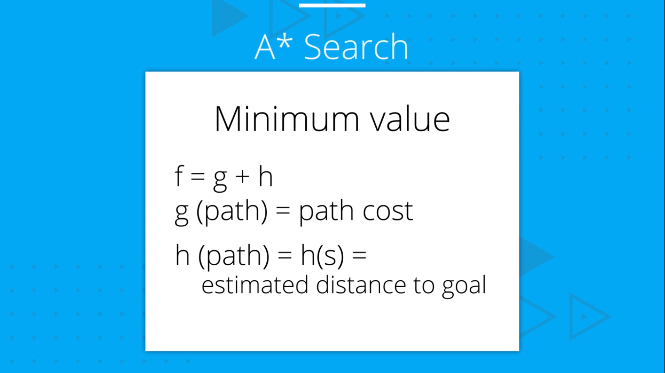
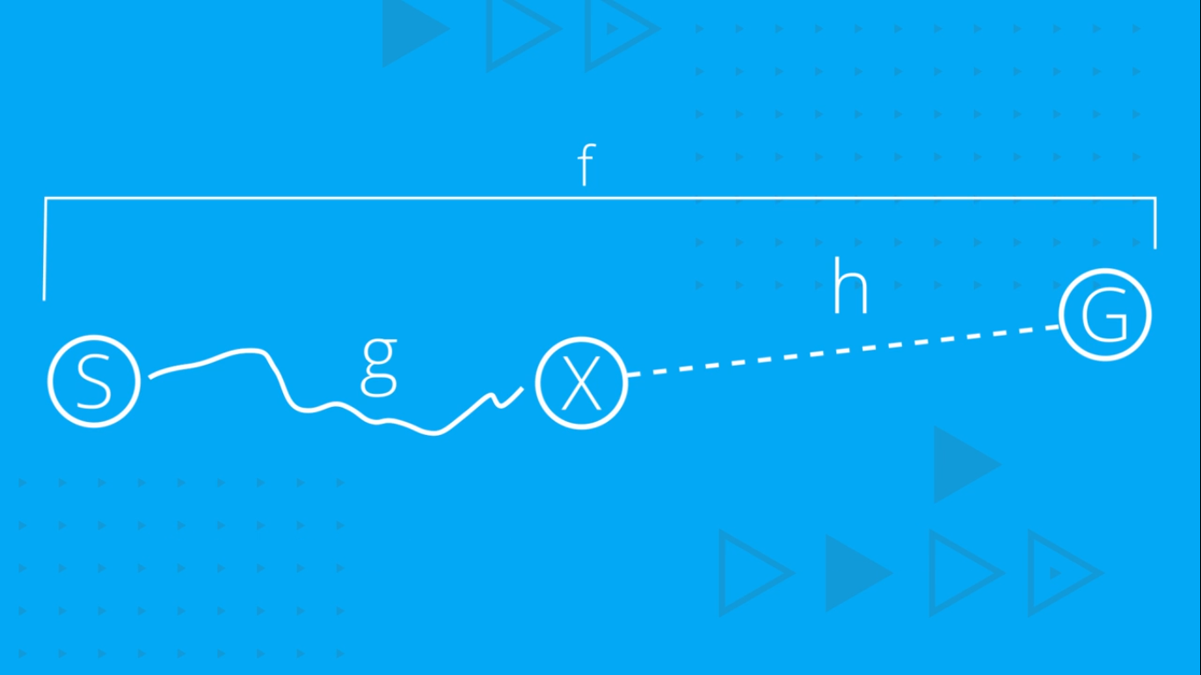

Slide 41
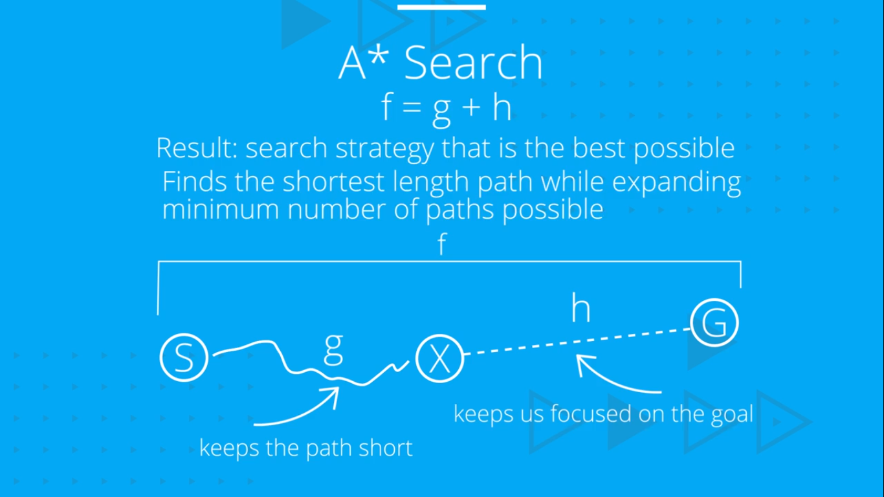
BEST ESTIMATED TOTAL PATH COST FIRST

Slide 42
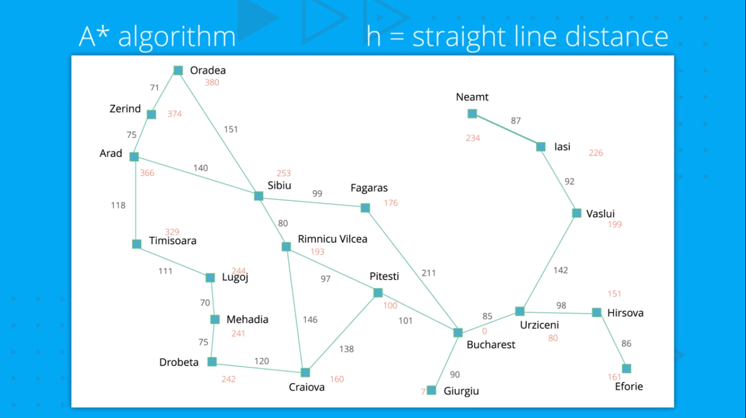

Slide 43
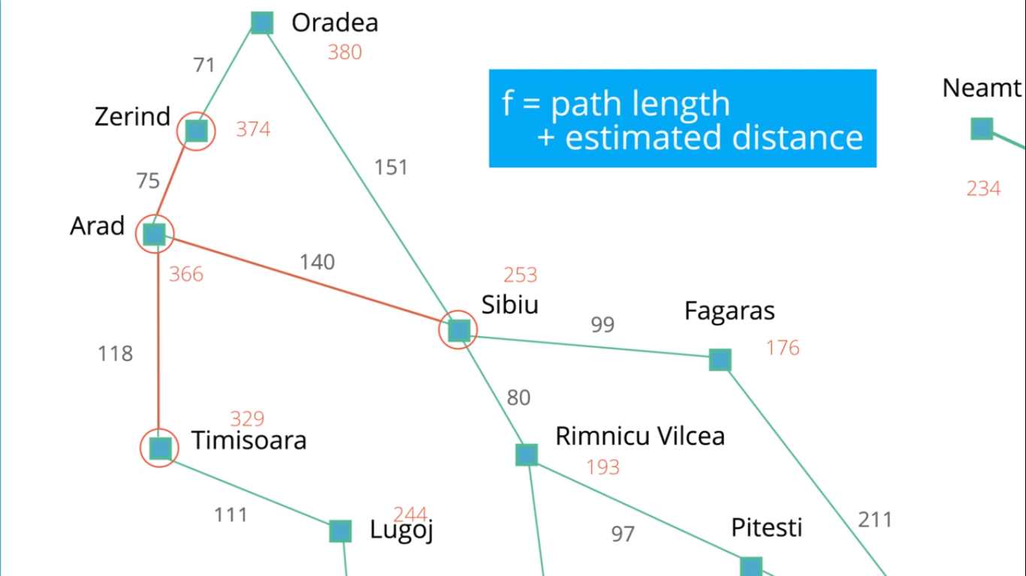

Slide 44
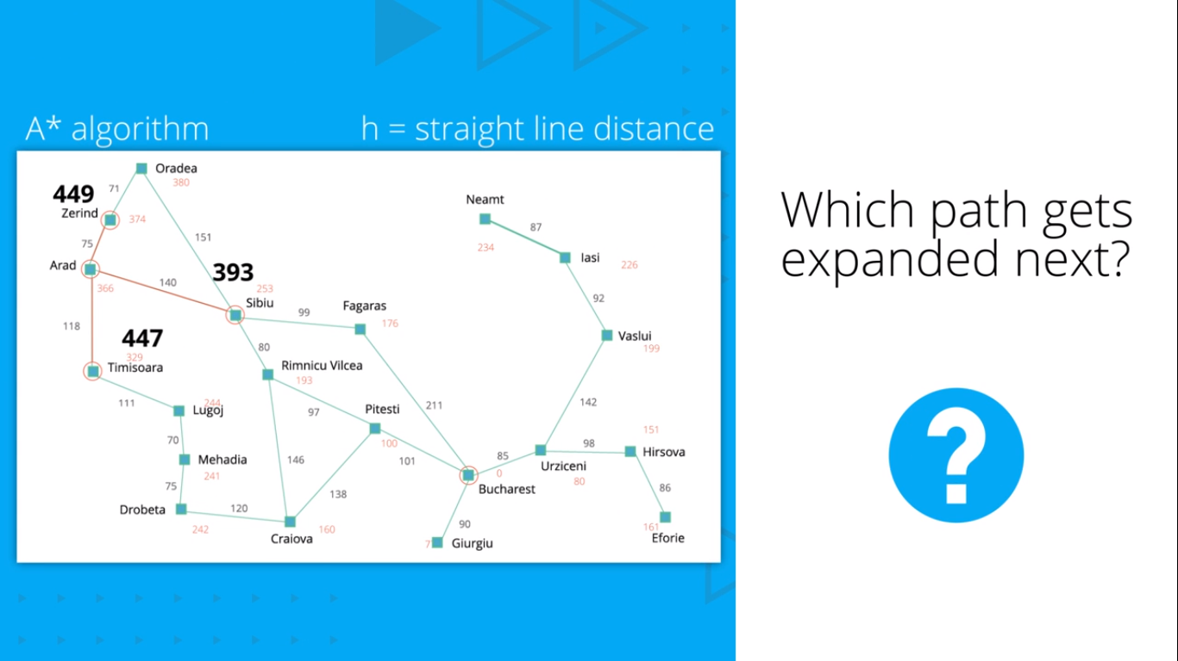
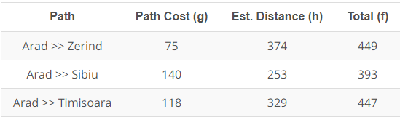

Slide 45

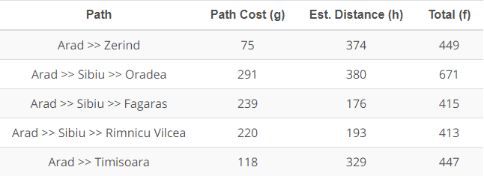

Slide 46

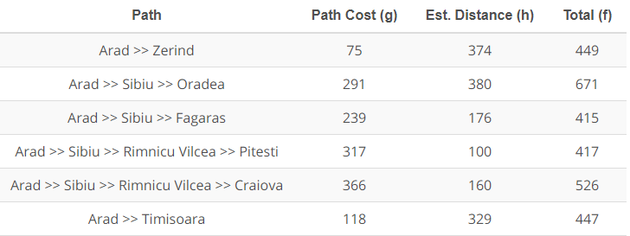

Slide 47
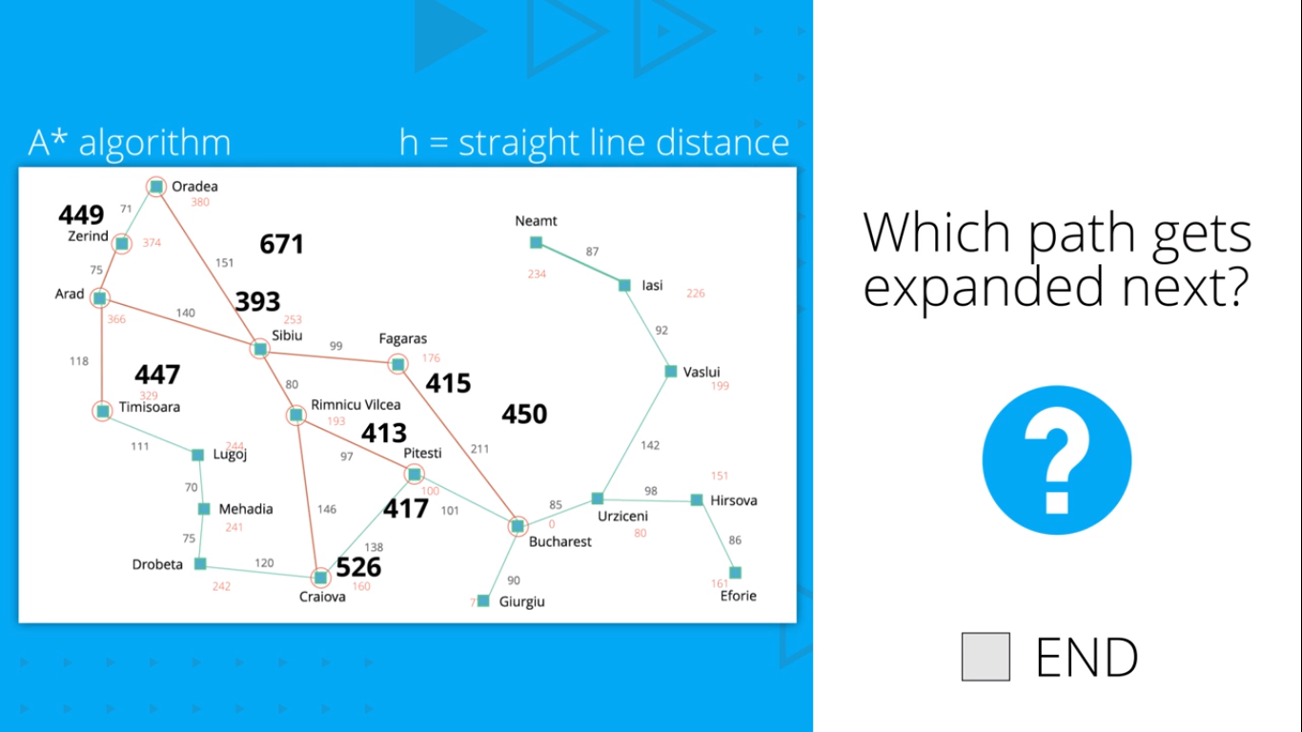

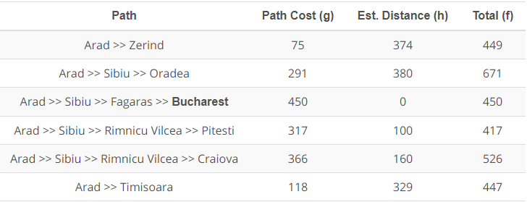

Slide 48
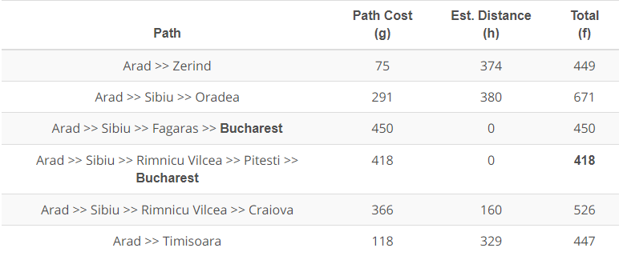
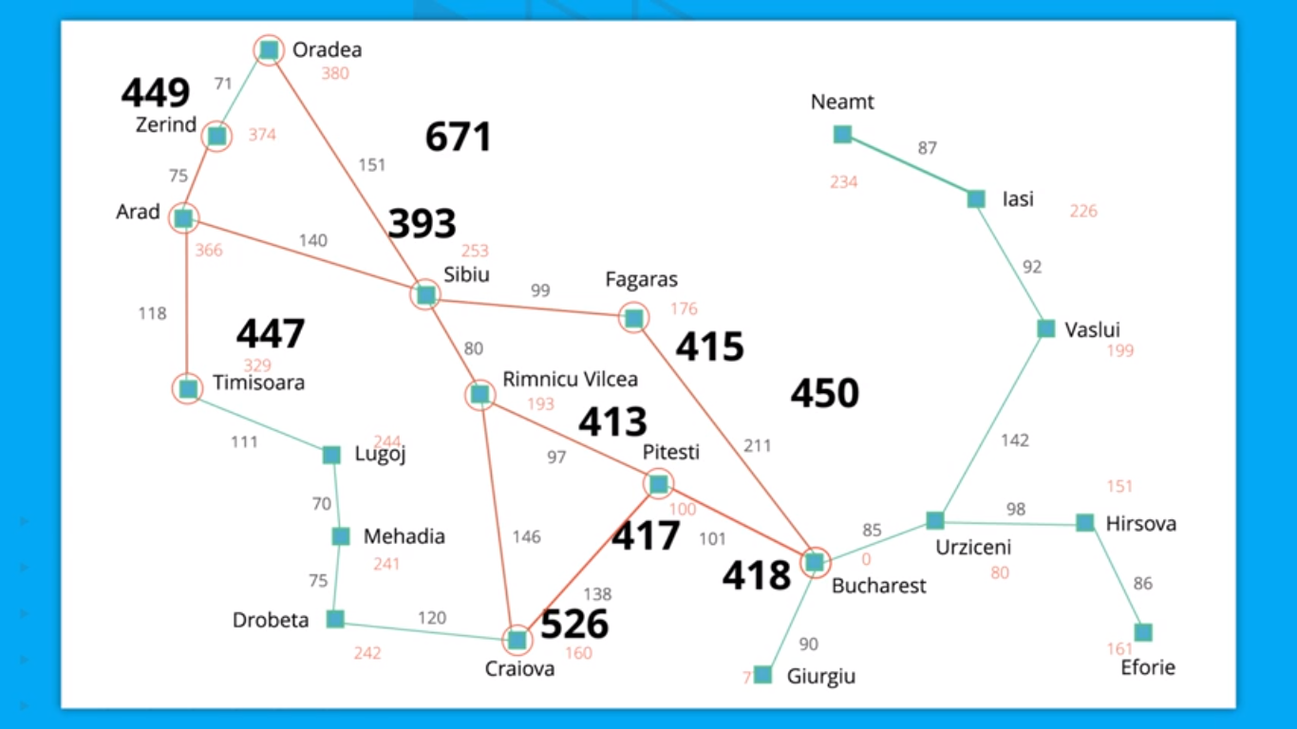

Slide 49
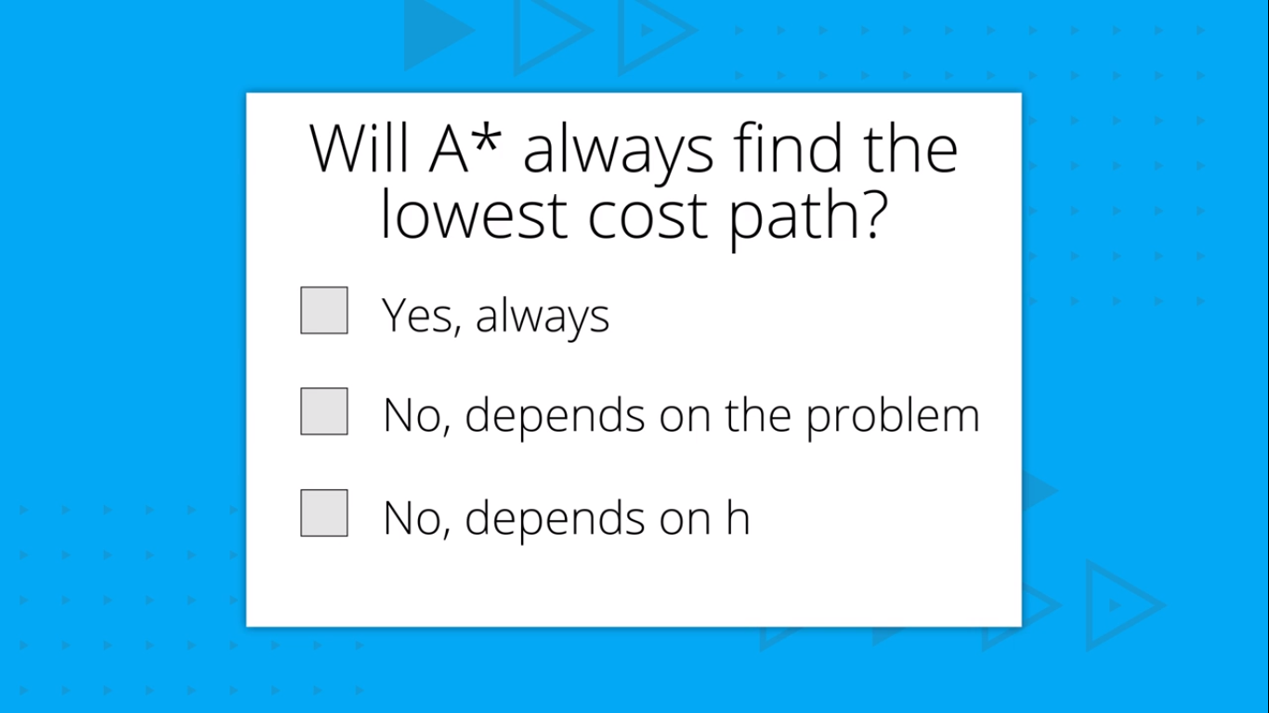

Slide 50
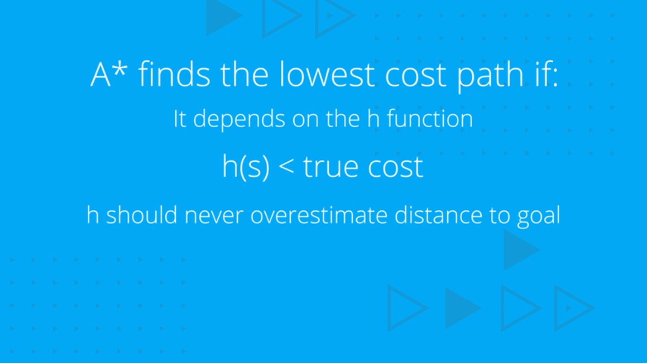

Slide 51
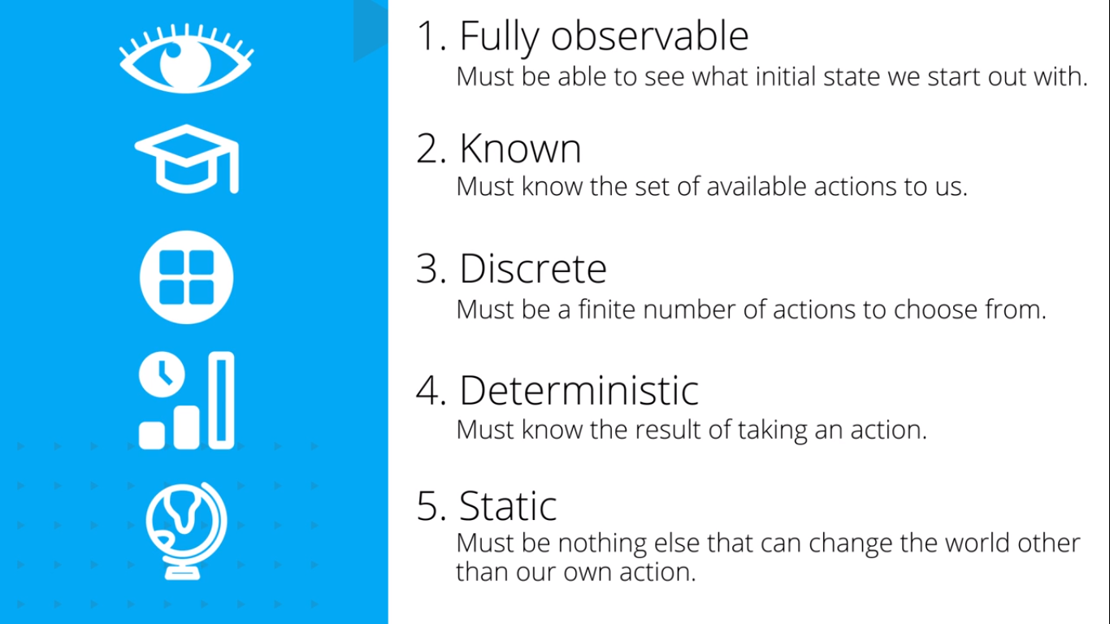
CONDITIONS FOR PROBLEM SOLVING BY SEARCHING

Slide 52
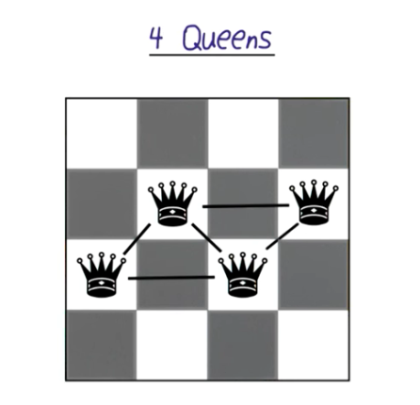

Constraint Satisfaction Problem
A constraint satisfaction problem is defined mathematically as a set of variables, a set of domains for each variable, and a set of constraints that limit which values in each domain are a valid assignment for each variable.
Sudoku
Sudoku CSP Definition
Variables: the 81 boxes that must be assigned a value
Domains: every variable has the same domain, the single digits 1-9
Constraints: each row, column, and 3x3 group must contain one of each digits 1-9
4-Queens
4-Queens CSP Definition
Variables: the row assignment of each of the 4 queens (the variables represent the queen assigned to each of the four columns)
Domains: every variable has the same domain, the single digits 1-4
Constraints: No pair of queens can be on the same row or diagonal
Map Coloring
Map Coloring CSP Definition
Variables: One for each region of the map (in this case WA, NT, SA, Q, NSW, V, and T)
Domains: All variables have the same domain, the list of colors that may be assigned to each region
Constraints: No pair of adjacent regions can have the same color

Slide 53
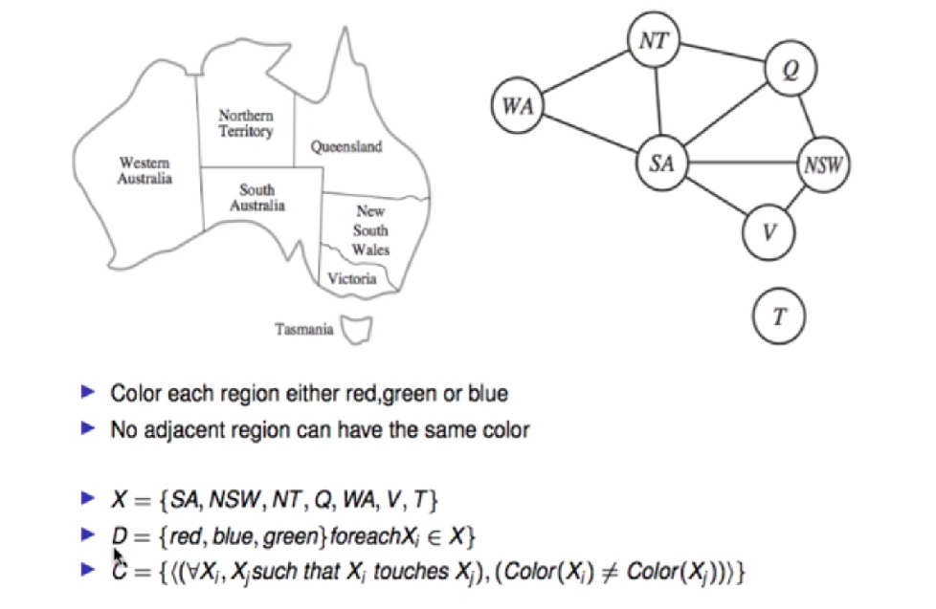
Constraint Graph

Slide 54
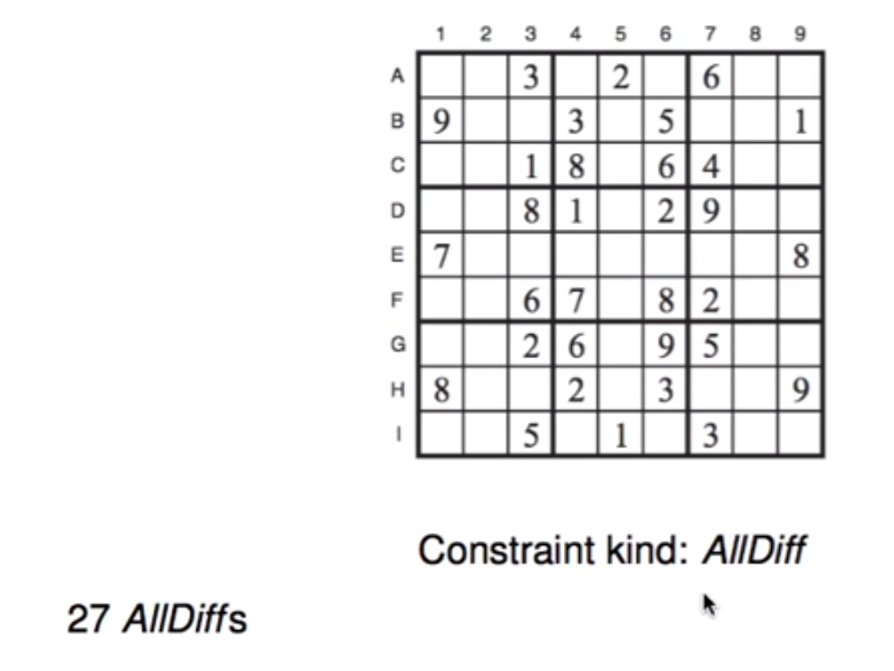
Sudoku

Slide 55
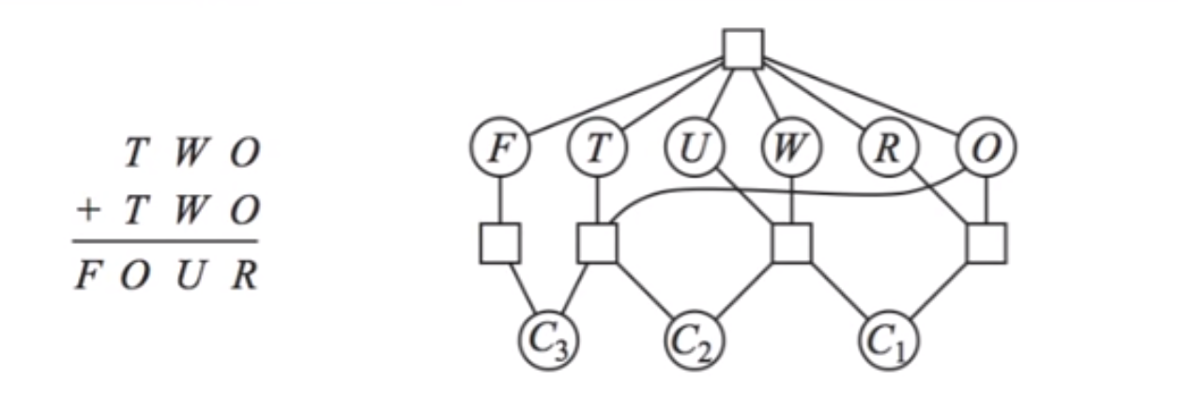
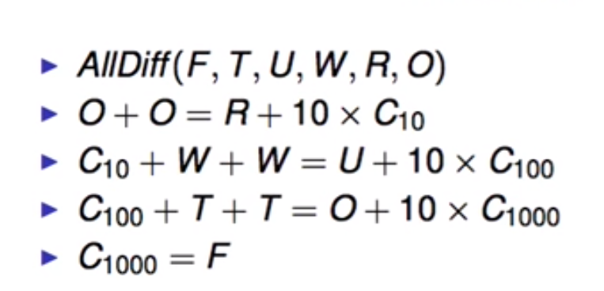
Cryptarithmetic Puzzle
Constraints???

Slide 56
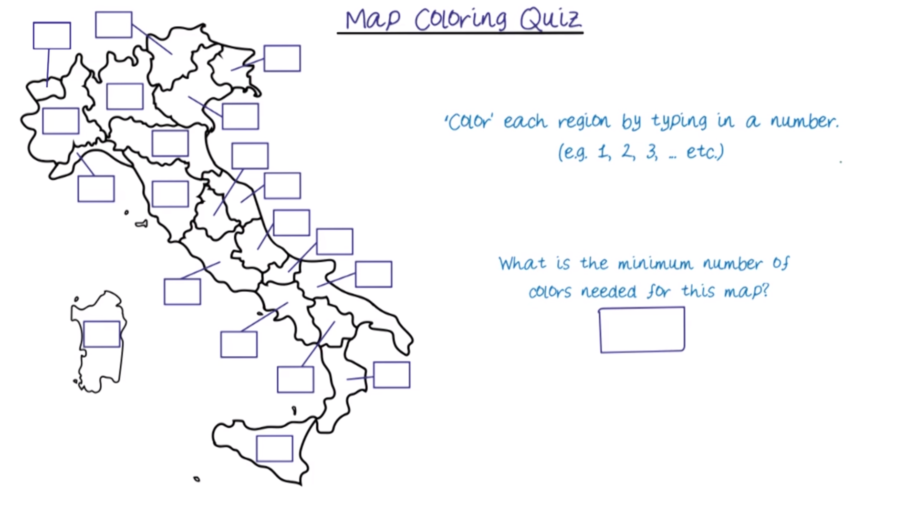

Slide 57
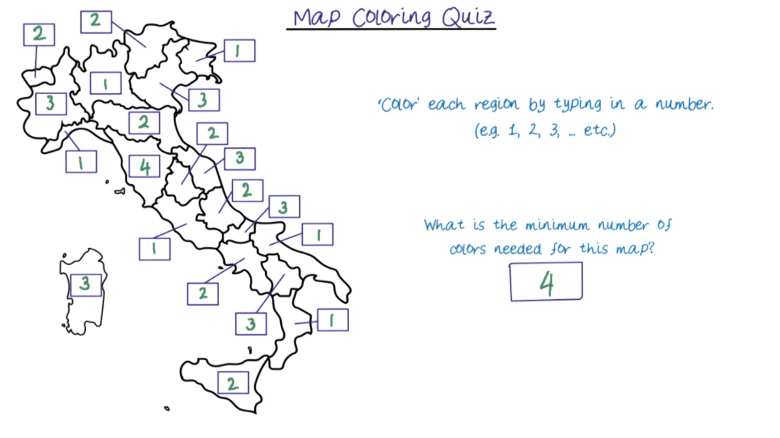

Slide 58
Types of Constraints
Types:
Unary
Binary
Constraints involving 3 or more variables
Soft Constraints
Constraint Optimization Problems
Solved using LPP
Give 2 examples for each

Slide 59
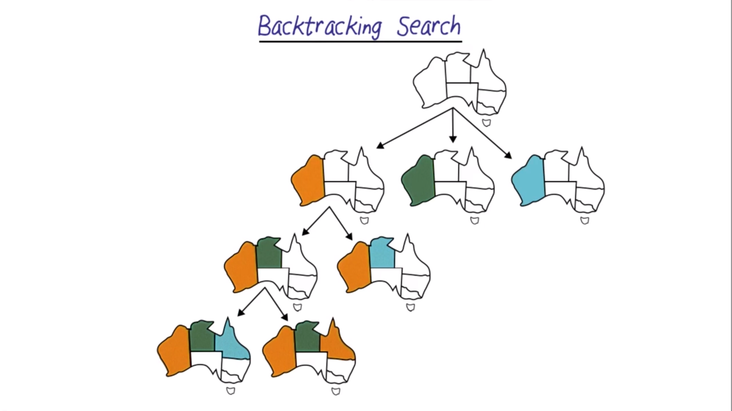

Slide 60
Optimizing Backtracking
How to choose next variables:
Degree heuristic: assign a value to the variable that is involved in the largest number of constraints on other unassigned variables.
Minimum remaining values (MRV): choose the variable with the fewest possible values.
Least-constraining value heuristic: choose a value that rules out the smallest number of values in variables connected to the current variable by constraints.
Forward Checking: Keep track of all permissible values for variables

Slide 61


Slide 62



Slide 63

Keep track of remaining legal values for unassigned variables
■ Terminate search when any variable has no legal values

Slide 64


Slide 65


Adversarial search
World Champion chess player Garry Kasparov is defeated by IBM’s Deep Blue chess-playing computer in a six-game match in May, 1997
© Telegraph Group Unlimited 1997

Slide 66
Games vs. search problems
"Unpredictable" opponent → specifying a move for every possible opponent reply
Time limits → unlikely to find goal, must approximate
Turn based games
Competitive : Commonly zero sum( One player wins and other loses)
Perfect Information: Player knows results of all previous moves
There is one best move for each player

Slide 67
Why study games?
Games are a traditional hallmark of intelligence
Games are easy to formalize
Games can be a good model of real-world competitive or cooperative activities
Military confrontations, negotiation, etc.

Slide 68
Types of game environments
 | Deterministic | Stochastic
Perfect information (fully observable)
Imperfect information (partially observable)
Chess, checkers, go
Backgammon, monopoly
Battleships
Scrabble, poker, bridge

Slide 69

Game Tree
Nodes are states
Edges are decisions
Levels are called “plys”

Slide 70


Slide 71
Notation
S₀ - Initial State
Player(s)- Who’s the player in state ‘s’
Actions(s) – Possible moves from state ‘s’
Result(s, a)- State after action ‘a’ is taken on state ‘s’
Terminal(s)-returns true if ‘s’ is a terminal state
Utility(s, p)- Objective function in state ‘s’ for player ‘p’

Slide 72

Game tree (2-player, deterministic, turns)

Slide 73
MINIMAX
Actions(s) and Result(s,a) defines a game tree
Two players Max and Min
Choose move which results in best state
Select highest expected score for you
Assume opponent is playing optimally too
Will choose lowest expected score for you
Minimax uses depth-first search
d is the maximum depth b is the branching-factor
Time complexity- ?
Space complexity- ?

Slide 74


Minimax
Choose a move to position with highest minimax value
Pick the best next move against your best move
E.g., 2-ply game:

Slide 75

Solve…

Slide 76


Slide 77

SOLVE …..

Slide 78

Alpha Beta Pruning

Slide 79

Alpha Beta Pruning

Slide 80


Slide 81

http://inst.eecs.berkeley.edu/~cs61b/fa14/ta-materials/apps/ab_tree_practice/

Slide 82


Slide 83

SOLVE…

Slide 84


Slide 85



Solve using DFS

Slide 86


Slide 87


Slide 88


Solve using A*
Initial State
GOAL State
Heuristic ?
f-score = h-score + g-score
h-score : Number of misplaced tiles by comparing the current state and the goal state (summation of the Manhattan distance between misplaced nodes)
g-score : Number of nodes traversed from start node to get to the current node.

Slide 89


Slide 90
Solve using A*
Initial State
GOAL State
Heuristic ?
H Score / M - Score
Hamming priority function: The number of blocks in the wrong position, plus the number of moves made so far to get to the state. (A state with a small number of blocks in the wrong position is close to the goal state, and we prefer a state that have been reached using a small number of moves.)
Manhattan priority function: The sum of the distances (sum of the vertical and horizontal distance) from the blocks to their goal positions, plus the number of moves made so far to get to the state.

Slide 91

Solve using Alpha Beta Pruning

Slide 92


Slide 93



Is the network arc-consistent ? If not, compute the arc-consistent network.

Slide 94


Slide 95
“Reasoning”?
 Reasoning is an act of deriving a conclusion from certain premises using a
given methodology.
 Reasoning is a process of thinking; logically arguing; drawing inference.
When a system is required to do something, that it has not been explicitly told how to do, it must reason. It must figure out what it needs to know from what it already knows.
Many types of reasoning have been identified and recognized, but many questions regarding their logical and computational properties still remained under controversy.
Popular methods of Reasoning include: Abduction, Induction, model- based, explanation and confirmation. All of them are intimately related to problems of belief revision and theory development, knowledge assimilation, discovery and learning.

Slide 96
When a system is required to do something, that it has not been explicitly told how to do, it must reason. It must figure out what it needs to know from what it already knows.
Example: Fact-1 : Robins are birds, Fact-2 : All birds have wings.
Then we can ask: DO ROBINS HAVE WINGS?
Reasoning is an act of deriving a conclusion from certain premises using
a given methodology.
 Any knowledge system must reason, if it is required to do something which has not being told explicitly.
 For reasoning system must find out, what it needs to know from what
it already knows.
Hence to answer the above question- some reasoning must go.

Slide 97
Human reasoning capabilities
Broadly it is being divided into three areas:
Mathematical Reasoning- axioms, definitions, theorems, proofs
Logical Reasoning- deductive, inductive, abductive
Non-logical Reasoning- linguistic, language
Above three mentioned are in every human being, but the ability level depends on education, genetics and environment.
Intelligent Quotient (IQ)= mathematical + logical reasoning, whereas, Emotional Quotient mostly depends on non-logical reasoning capabilities.
Logical Reasoning is our major concern in AI.

Slide 98
Logical Reasoning
 Logic is a language of reasoning. It is a collection of rules called logic arguments,
we use when doing logical reasoning.
 Logical Reasoning is a process of drawing conclusions from premises using rule of
inference.
The study of is divided into two: formal and informal logic.
The formal logic is sometimes called symbolic logic.
 Symbolic logic is the study of symbolic abstraction (construct) that capture the formal features of logical inference by a formal system.
 Formal system consists of two components, a formal language and a set of
inference rules. The formal system has axioms.
 Axiom is a sentence that is always true within the system.
 Sentences are derived using the system’s axioms and rules of derivation are called theorems.

Slide 99
Formal Vs Informal Logic
Formal Logic
 The formal logic is the study of inference with purely formal content,
i.e. where content is made explicit. Eg:
Propositional logic and Predicate Logic.
Here the logical arguments are set of rules for manipulating symbols. The rules are of two types:
Syntax rules: how to build meaningful expressions.
Inference rules: how to obtain true formulas from other true formulas.
Logic also need semantics, which says how to assign meaning to expressions.
Informal Logic
The informal logic is study of natural language arguments.
The analysis of argument structures in ordinary language is part of informal logic
The focus lies in distinguishing good arguments (valid) and bad arguments (invalid).

Slide 100
Formal systems
Formal system can have following three properties:
Consistency: system’s theorems do not contradict
Soundness: system’s rules of derivation will never infer anything false, so long as start is with only true premises.
 Completeness: there are no true sentences in the system that cannot be proved using
derivation rules of the system.
Elements of formal systems:
The finite set of symbols for constructing formulae.
A grammar, is the way of constructing well-formed formulae (wff).
A set of axioms; each axiom has to be a wff.
A set of inference rules.
A set of theorems.
A well-formed formulae, wff, is any string generated by a grammar. Example: the
sequence of symbols ((a→b)→(~b→~a)) is a WFF because its is grammatically correct in propositional logic.

Slide 101
Formal Language
A formal language may be viewed as being analogous to a collection of words or a collection of sentences.
In computer science, a formal language is defined as precise mathematical or machine process able formulas.
A formal language L is characterized as a set F of finite length sequences of
elements drawn from a specified finite set A of symbols.
The mathematical theory that treats formal language in general is known as formal language theory.

Slide 102
Uncertainty in Reasoning
 The world is an uncertain places; often the knowledge is imperfect which causes
uncertainty. Therefore reasoning must be able to operate under uncertainty.
AI systems must have ability to reason under conditions of uncertainty.
Incompleteness knowledge→ compensate for lack of knowledge.
Inconsistencies knowledge→ Resolve ambiguities and contradictions
Changing knowledge→ update the knowledgebase over time.

Slide 103
Methods of reasoning
 To a certain extend this will depend on the chosen knowledge representation.
Although a good knowledge representation scheme has to allow easy, natural, and
plausible reasoning.
Three types of logical reasoning:
Deduction
Induction
Abduction

Slide 104
Deductive Reasoning
 Deductive Reasoning is a process in which general premises are used to obtain a
specific inference. Reasoning moves from a general principle to a specific
conclusion.
Example: Premise : I wash my car when the weather is good on weekends.
Premise: Today is Sunday and the weather is hot
Conclusion: Therefore, I will wash my car today.
 To use deductive reasoning the problem must generally be formatted in this way. Once the format has been achieved , the conclusion must be valid if the premises
are true. The whole idea is to develop new knowledge from previously given
knowledge.
 One of the basic rules of inference of deductive logic is the modus ponens rule.
A formal English statement of this rule is : If X is true and if X being true implies Y is true then Y is true. (X∧(X→Y)→Y
Example: All cats are felines. Bosty is a cat. I can deduce that Bosty is a feline

Slide 105
Abduction Reasoning
Abduction is a form of deductive logic which provides only a ‘plausible inference’.
For instance:
If I read Smoking causes lung cancer and Frank died of lung cancer , I may infer that Frank was a smoker. Again this may or may not be true. Using statistics and probability theory , abduction may yield the most probable inference among many possible inferences.
Abduction is heuristic in the sense that it provides a plausible conclusion consistent with available information, but one which may in fact be wrong. To illustrate how
abduction works, consider following logical system consisting of a general rule and
a specific proposition:
1)All successful , entrepreneurial industrialists are rich persons. 2)John is a rich person.
 If this was only information available, a plausible inference would be that John was a successful , entrepreneurial industrialist. This conclusion could also be false since there are other roads to riches such as inheritance , the lottery...If we had a table of the income distribution of wealthy persons along with their personal histories, we could refine our abduction inference with the probability of the inference being true .

Slide 106
Inductive Reasoning
 A principle of reasoning to a conclusion about all members of a class from examination
of only a few members of the class; broadly, reasoning from the particular to the
general.
 For example :

In 1998, The best model of Turkey is from İzmir In 1999, The best model of Turkey is
from İzmir In 2000, The best model of Turkey is from İzmir I would logically infer that all
the girls from İzmir is beautiful.
This may or may not be true. But it provides a useful generalization.
Another example :
Falcon can fly. Canary can fly. Gull can fly.
Conclusion: Birds can fly.

The outcome of the inductive reasoning process will frequently contain some measure
of uncertainty because including all possible facts in the premises is usually impossible. Deductive or inductive approaches are used in logic, rule-based systems, and frames.

Slide 107
Other types of Reasoning
 Analogical Reasoning: Analogical reasoning assumes that when a question is
asked, the answer can be derived by analogy.
 Example: Premise : All football teams gets 3 point when they win. Question: How many points did GS take this weekend?
Conclusion: Because GS is a football team and won, hence, they took 3 points.
 Analogical reasoning is a type of verbalization of an internalized learning process.
An individual uses processes that require an ability to recognize previously encountered experiences. The use of this approach has not been exploited yet in AI field. However, case-based reasoning is an attempt.

Slide 108
Other types of Reasoning
Formal Reasoning: Formal reasoning involves syntactic manipulation of data structures to deduce new facts. A typical example is the mathematical logic used in proving theorems in geometry.
Procedural Numeric Reasoning: Procedural numeric reasoning uses mathematical models or simulation to solve problems. Model-based reasoning is an example of this approach.
Generalization and Abstraction: Generalization and abstraction can be successfully used with both logical and semantic representation of knowledge.
Meta level Reasoning: Meta level reasoning involves “knowledge about what you know”. Which approach to use, how successful the inference will be, depends to a great extent on which knowledge representation method is used. For example; reasoning by analogy can be more successful with semantic networks than with frames.

Slide 109
Reasoning with LOGIC
 We utilize various rules of inference to manipulate the logical expressions to create new
expressions.
 Modus Ponens

If there is a rule “if A, then B,” and if we know that A is true, then it is valid to conclude
that B is also true. [A AND (A →B)] →B
Example : A: It is rainy. B: I will stay at home. A→B : If is rainy, I will stay at home.
Modus Tollens

When B is known to be false, and if there is a rule "if A, then ,” it is valid to conclude that
A is also false.
 Resolution is a method of discovering whether a new fact is valid, given a set of logical
statements. It is a method of “theorem proving”. The resolution process, which can be computerized because of its well-formed structure, is applied to a pair of parent clauses to produce a derived new clause.

Slide 110
More about Reasoning
Monotonic Reasoning [Preferred in Certainty]- Monotonic reasoning is static, in other words the truth of the statement doesn’t change when any new information is added.
Non-Monotonic Reasoning [Preferred in uncertainty]- In real life we frequently
deal with non-monotonic reasoning. In these situations the truth of a statement
can change when a new information is added.
Shallow and Deep Reasoning.
Inheritance Method
Pattern- Matching Method
 Meta-Rules: Meta-rules are the rules about rules. They are used for deciding about which rules to use next. Meta-rules make the knowledge base harder to read and
understand because one meta-rule affects the sequence in which all other rules are
called.
 Conflict Resolution

Slide 111
Alternative Reasoning Methods
 Theorem Proving
 emphasis on mathematical proofs and correctness, not so much on performance and
ease of use
Probabilistic Reasoning
integrates probabilities into the reasoning process
Certainty Factors
Express subjective assessment of truth of fact or rule
Fuzzy Reasoning
allows the use of vaguely defined predicates and rules

Slide 112
Reasoning Types
Model –based Reasoning
Case-based Reasoning
Rule-based Reasoning
Blackboard Systems.
Truth Maintenance systems.

Slide 113
Model Based Reasoning
In artificial intelligence, model-based reasoning refers to an inference method used in expert systems based on a model of the physical world.
With this approach, the main focus of application development is developing the model.
Then at run time, an "engine" combines this model knowledge with
observed data to derive conclusions such as a diagnosis or a prediction.
In a model-based reasoning system knowledge can be represented using
causal rules.

Slide 114
Case-Based Reasoning
Case-based reasoning (CBR), broadly construed, is the process of solving new problems based on the solutions of similar past problems.
An auto mechanic who fixes an engine by recalling another car that exhibited similar symptoms is using case-based reasoning.
A lawyer who advocates a particular outcome in a trial based on legal precedents
or a judge who creates case law is using case-based reasoning.

Slide 115
Rule-based Reasoning
A particular type of reasoning which uses "if-then-else" rule statements.
As mentioned above, rules are simply patterns and an inference engine searches for patterns in the rules that match patterns in the data.
 The "if" means "when the condition is true," the "then" means "take action A" and
the "else" means "when the condition is not true take action B."
 Here is an example with the rule PROBABLE CAUSE:
 IF robbery is TRUE AND suspect witness identification is TRUE AND suspect physical evidence is TRUE AND suspect lacks alibi is TRUE THEN probable cause is TRUE ELSE round up usual suspects

Slide 116
Black-board Reasoning
 A blackboard system is an artificial intelligence application based on the blackboard architectural model, where a common knowledge base, the "blackboard", is iteratively updated by a diverse group of specialist knowledge sources, starting with a problem specification and ending with a solution.
 Each knowledge source updates the blackboard with a partial solution when its
internal constraints match the blackboard state.
 In this way, the specialists work together to solve the problem.
 The blackboard model was originally designed as a way to handle complex, ill- defined problems, where the solution is the sum of its parts.

Slide 117
Truth Maintenance System
Necessary when changes in the fact-base lead to inconsistency / incorrectness among the facts non-monotonic reasoning
A Truth Maintenance System tries to adjust the Knowledge Base or Fact Base upon changes to keep it consistent and correct.
A TMS uses dependencies among facts to keep track of conclusions and
allow revision / retraction of facts and conclusions.

Slide 118
Confidence Factor (CF)
A certainty factor (CF) is a number that reflects the degree of belief in a hypothesis.
Positive certainty factors indicate that there is evidence that the hypothesis is valid.
The larger the CF, the greater is the belief in the hypothesis.
When CF is 1, the hypothesis is known to be correct.
Negative CF suggests that the hypothesis is false.
A small CF indicates that there is a greater belief that the hypothesis is invalid.
CF -1 implies that the hypothesis is effectively disapproved.
CF o implies that there is neither evidence regarding the hypothesis being true nor false.

Slide 119
Reason for uncertainty
Due to incomplete knowledge
Due to incorrect knowledge
Data derived from assumptions
Inconsistency between knowledge from different experts
Bad choice of knowledge representation mechanism
Incomplete because of some conditions are unknown
Uncertainty in rules or inference process

Slide 120
Approaches of reasoning under
uncertainty
Symbolic reasoning
Statistical reasoning
Fuzzy logic reasoning

Slide 121
Symbolic Reasoning
Monotonic and non-monotonic reasoning (defined already)
Non-monotonic:
Default reasoning: The conclusions are drawn based on what is most likely to be true.
Circumscription: To formalize the common sense assumptions. It is a
formalized rule of guess that can be used along with the rules of
inference of FOL.
3. Truth maintenance system (already discussed).

Slide 122
Statistical Reasoning
In logic based reasoning, we believe that everything is either TRUE or FALSE.
However, it is often useful to represent the fact that we believe such that something is probably true
This is useful for dealing with problems where there is Randomness and Unpredictability and also for dealing with problems where we could, if we had sufficient information, work out exactly what is true.
To do all this in a principled way requires techniques for Probabilistic Reasoning. Further, first we will discus Bayesian Probability Theory and then, later on, how uncertainties are treated.

Slide 123
Certainty Factors and Rule-Based Systems
Practical way of compromising on pure Bayesian system was pioneered in the MYCIN system
Example
If: (1) the stain of the organism is gram-positive, and
(2) the morphology of the organism is coccus,
(3)the growth of conformation of the organism is clumps, then there is a suggestive evidence (0.7) that the identity of the organism is staphylococcus
Internally the rule is represented as

Slide 124
A certainty factor CF[h,e] is defined interms of two components:
1. MB[h,e] - a measure (between 0 and 1) of belief in hypothesis h given the evidence e
2. MD[h,e] - a meaure (between 0 and 1) of disbelief in hypothesis h given the evidence e.
CF[h,e] - is the certainty factor and is defined as
CF[h,e] = MB[h,e] - MD[h,e]
Since any particular piece of evidence either supports or denies a hypothesis, a single number suffices to define both MB and MD and thus the CF
Combination Of Multiple Pieces Of Evidence A
C
B
MB[h,s1 ^s2] = 0 if MD[h,s1 s2]=1
= MB[h,s1] +MB[h,s2].(1-MB[h,s1]) otherwise
MD[h,s1 ^s2] = 0 if MB[h,s1 s2]=1
=MD[h,s1] +MD[h,s2].(1-MD[h,s1]) otherwise

Slide 125
Combination Of Multiple Pieces Of Evidence (continue)
A and B
MB[h1 and h2,e] = min(MB[h1,e],MB[h2,e])
A or B
MB[h1 or h2,e] = max(MB[h1,e], MB[h2,e])
A B C
MB[h,s] = MB/[h,s]. max(0, CF[s,e])

Slide 126
Dempster-Shafer Theory
This approach considers sets of propositions and assign to each of them an interval :
[Belief, Plausibility]
Belief (Bel) measures the strengthof the evidence in favor of a set of propositions. It ranges from 0 (no evidence) to 1 (certainty)
Plausibility(Pl) measure the extent to which evidence in favor of - s leaves room for belief in s . It also ranges from 0 to 1 and is defined as:
Pl(s) = 1 - Bel(- s)
Q is an exhaustive universe of mutually exclusive hypotheses (frame of discrement)

Slide 127
Advantages
The approach makes strong independence assumptions that make it relatively easy to use
The approach can serve as the basis of practical application programs
It appears to mimic the way people manipulate certainities
Disadvantages
The assumption of independency creates danger if rules are not written carefully
No solid theoretical basis

Slide 128
m(p) measure the amount of belief that is currently assigned to exactly the set p of hypotheses.
If Q contains n element then there are 2n subsets of Q. We must assign m so that the sum of all the m values assigned to the subset of Q is 1
Although dealing with 2n values may appear intractable, it usually turns out that many of the subsets will never need to be considered.
Suppose we are given two belief functions m1 and m2 . Let X be the set of subsets of
Q to which m1 assigns a nonzero value
and let Y be the corresponding set of m2.
We define the combination m3 of m1 and m2 to be :
ΣX Λ Y = Z m1(X). m2(Y)
m3 (Z) =
1- ΣX Λ Y = φ m1(X). m2(Y)

Slide 129
Example
Assume that Q = {A,F,C,P} where A: allergy, F: flu, C: cold, P: pneumonia
Our measure of belief before observing any sypmtom is: m(Q) = 1.0
suppose that m1 corresponds to our belief after observing fever:
m1 ({F,C,P}) = 0.6
m1 (Q) = 0.4
suppose that m2 corresponds to our belief after observing fever:
m2 ({A,F,C}) = 0.8
m2 (Q) = 0.2
Computing the combination m3
 |  | m2({A,F,C}) | 0.8 | m2 (Q) | 0.2
m1({F,C,P}) | 0.6 | m3({F,C}) | 0.48 | m3({F,C,P}) | 0.12
m1(Q) | 0.4 | m3{A,F,C} | 0.32 | Q | 0.08

Slide 130
Now let m₄ corresponds to our belief given just the evidence that the problem goes away when the patient goes on a trip
m₄ ({A}) = 0.9
m₄ (Q) = 0.1
 |  | m4({A}) | 0.9 | m4(Q) | 0.1
m3({F,C}) | 0.48 | F | 0.432 | {F,C} | 0.048
m3({A,F,C}) | 0.32 | ({A}) | 0.288 | {A,F,C} | 0.032
m3({F,C,B}) | 0.12 | F | 0.108 | {F,C,B} | 0.012
m3(Q) | 0.08 | ({A}) | 0.072 | Q | 0.008
m₅({F,C}) | 0.104
m₅({A,F,C}) | 0.070
m₅({F,C,B}) | 0.026
m₅({A}) | 0.783
m₅(Q) | 0.017
But there is now a total belief of 0.54 associated with Φ; only 0.46 is associated with outcomes that are in fact possible. So we need to scale the remaining values by the facor 1 - 0.54 = 0.46 .
Then m₅ is

Slide 131
Disclaimer
The content in the slides is amalgamated from web and not my own

